Slide 1
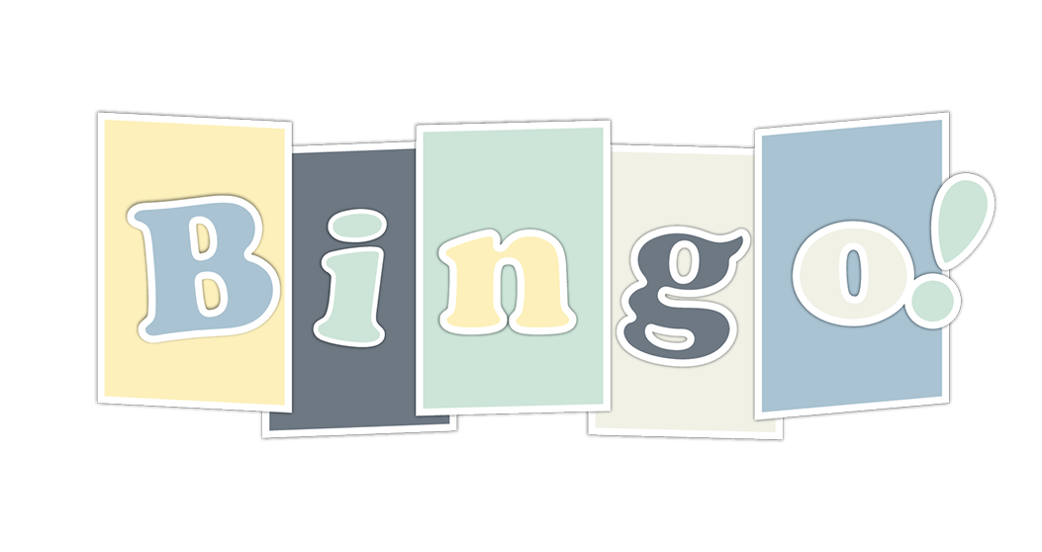
Bingo – Team #1
Joshua Wallace
Greg Knight
Sidney Eubanks
Elinor Huntington
Linus Carlsson
Armand Flores

Slide 2
Team Members
Joshua Wallace – Manager & Control Flow
Greg Knight – GUI & Events
Sidney Eubanks – Game Logic & Graphics
Elinor Huntington – GitHub & Diagrams
Linus Carlsson – Audio & UML
Armand Flores – Research

Slide 3
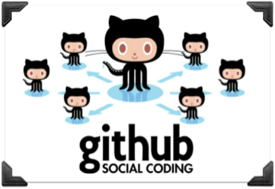

How We Communicate
GitHub
Google Groups
Texting
After Class Meetings

Slide 4
Why GitHub?
Elinor Huntington
I was learning Git for my JPL internship
I thought it would be a good way to organize our work, especially when it came time to code
Put together a mini boot camp for my team members
It lasted about 4 hours…

Slide 5
What is Git?
Git is version control
Tracks changes made to files and directories
Mainly used for managing source code
Simple version control examples:
Microsoft Word’s “Track Changes”
Undo Buttons

Slide 6
Git Basics
Distributed version control
Distributed means there is no definitive, centralized repository so the chance of losing your code entirely is almost null
Everyone can push & pull from the repo and stay up to date with each other
Version control basically means you have a history of what changes were made

Slide 7
How We Used GitHub
Set up a GitHub account
Synced all of our source code
Used GitHub’s “Issues” to keep track of what needs to be done
Issues could be claimed or assigned so that no two people were working on the same thing

Slide 8

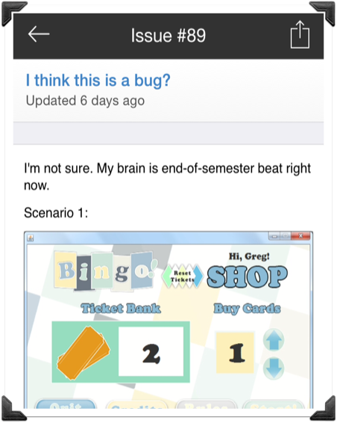
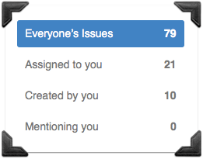
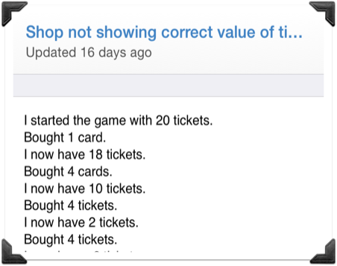
Issues

Slide 9
Google Groups
Joshua Wallace
I had used Google Groups with other projects
It’s a good way to communicate ideas in a group with threaded conversations
It turned out to work at first but kind of fell off the radar after we got started coding

Slide 10
Team Communication Summary
GitHub was a godsend
Google Groups was OK
After-class meetings helped each of us understand other members’ code
Texting was great for squashing bugs
Overall, everyone communicated, got along, and accomplished what we set out to do.
So, what did we set out to do?

Slide 11
Did we live up to our Specification?
We set out to create a Bingo game with multiple cards, number calling, random computer opponents, card purchasing, card history, pattern checking, and much more.
In fact, we did all of those things as well as implemented the persistent/multiple user enhancement we thought we might not get to

Slide 12
Now let’s play the game and come back to the presentation afterwards!

Slide 13

How We Coded
Each of us used NetBeans 7.4 to write code and used GitHub to sync changes
NetBeans helped by providing autocompletion and debugging which are invaluable at this scale

Slide 14
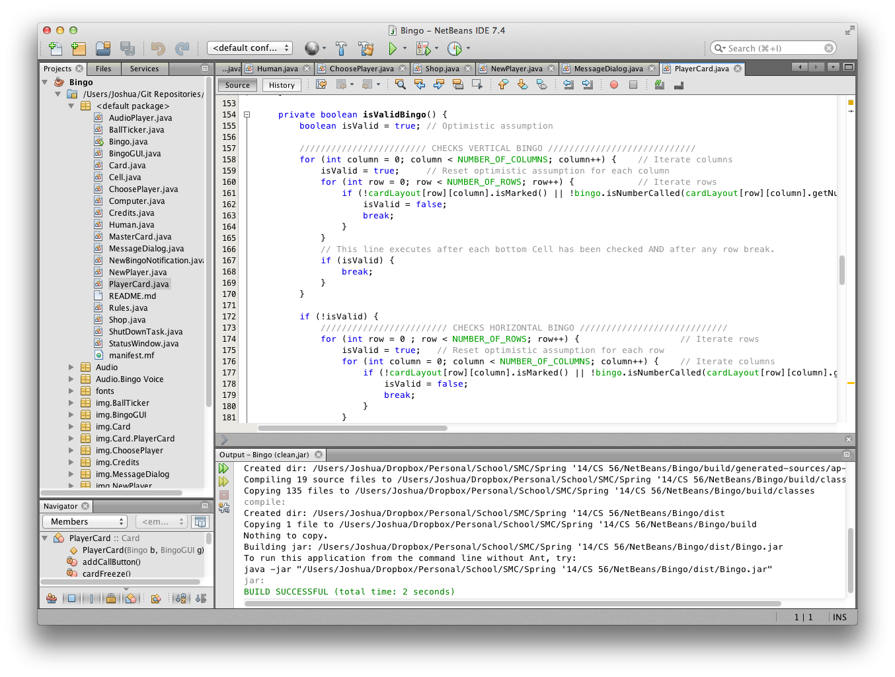

Slide 15
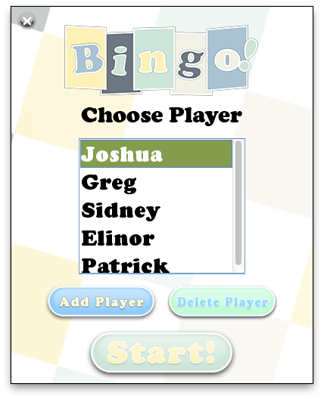

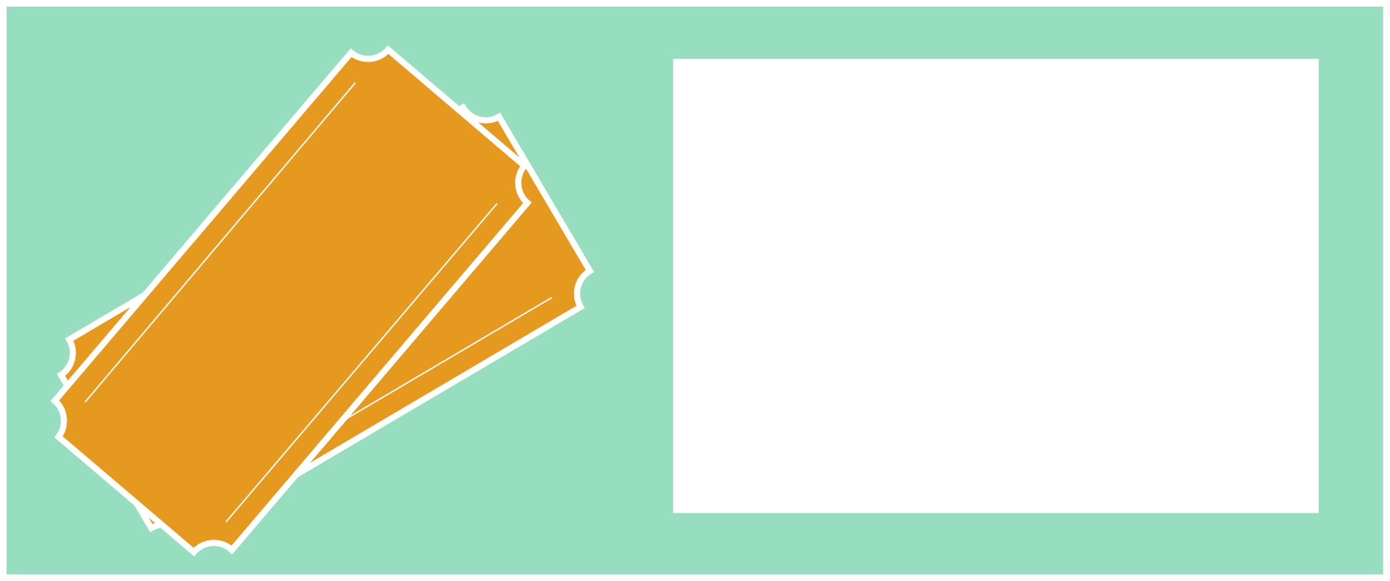
Graphic Design
Sidney Eubanks
For the design stage of the app I was tasked with creating that “look and feel” of the Bingo game board, pieces, and GUIs.
Ticket Bank

Slide 16
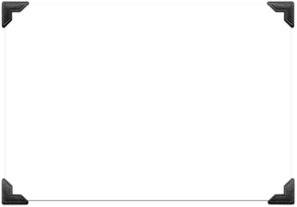
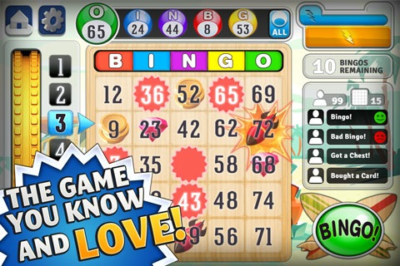
Understanding Bingo
I spent a significant amount of time playing different versions of the game, from different developers, and decided on what I thought were the best features of each game that our flow of play should have.
Bingo! by Shark Party
On the App Store

Slide 17
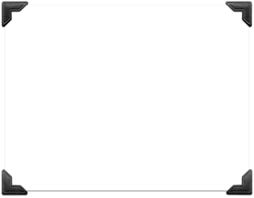
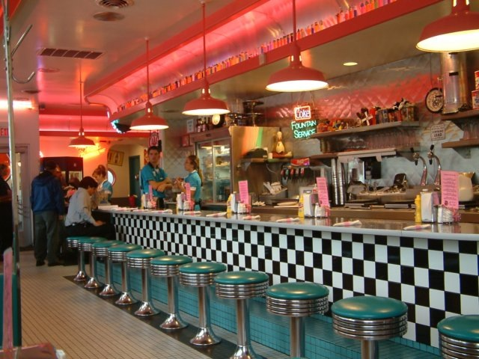
Choosing A Theme
60’s Diner
Pay attention to existing Bingo game designs
Keep an original look to set game apart from the rest
Settled on 60’s/70’s theme
Bingo Logo

Slide 18
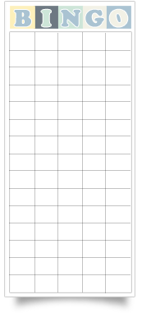
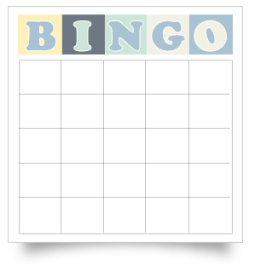
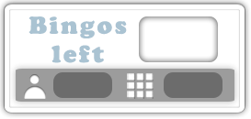






Designing the Game
Despite planning, new obstacles would come up.
Two parts: intended and unintended design.
Planned Graphics
History
Card
Marker
Status Window
Call Button
Balls

Slide 19


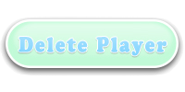
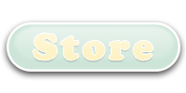
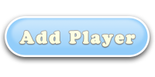


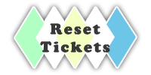


Designing the Game
Unplanned Graphics
Examples of graphics that I hadn’t planned on being part of the game.
Created as new features were added to the game
Ticket Bank
Close
Multiplayer Buttons
Shop Buttons

Slide 20
Now for some of the code. This is by no means all of it…

Slide 21
Control Flow
Joshua Wallace
One of the trickiest things to understand/implement was how the game would loop and flow
For instance:
Which class should start a new Bingo game instance?
Should the Shop have a new instance every time or be persistent?
Who holds the players?
How will we know when a Bingo game has ended and it’s time to return to the shop interface?

Slide 22
Control Solution
Main calls new Shop class which remains persistent
Shop creates the human player which, in turn, presents the dialogs for managing multiple users
Once the user has chosen to start a new Bingo game, Shop creates a new Bingo instance and immediately starts a new thread that awaits a Condition to be signaled that no Bingos are left to be won.
The Shop interface reappears and the Bingo instance is cleaned up and dereferenced for the process to repeat.

Slide 23
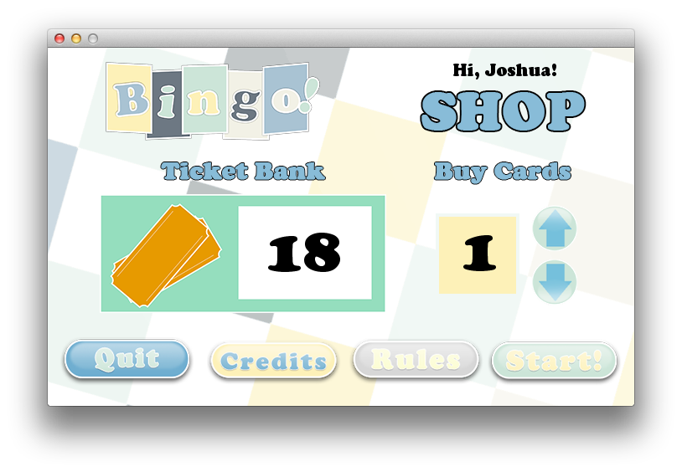
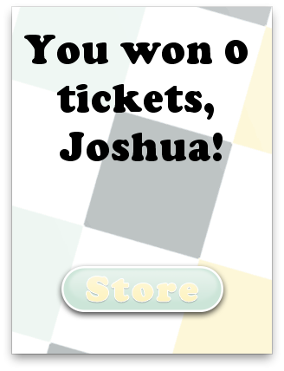
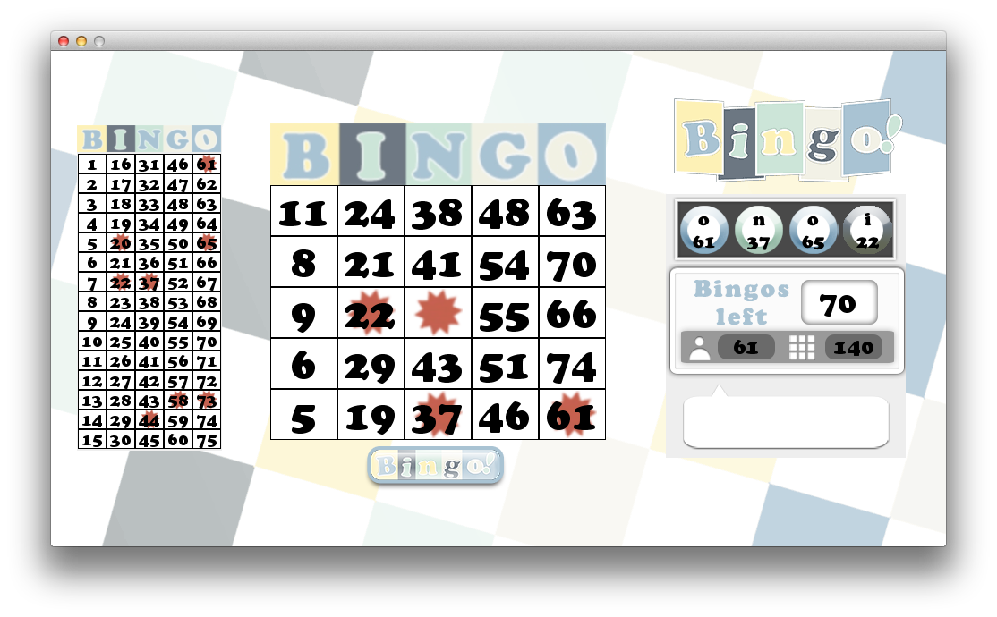
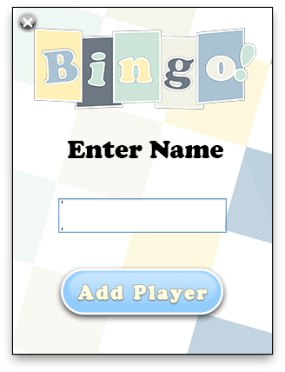
Flow Screenshots
:(

Slide 24
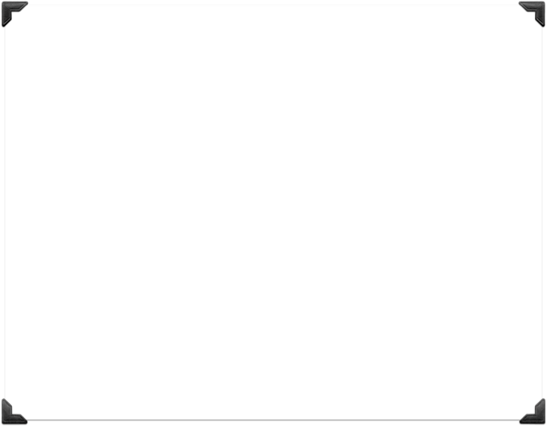
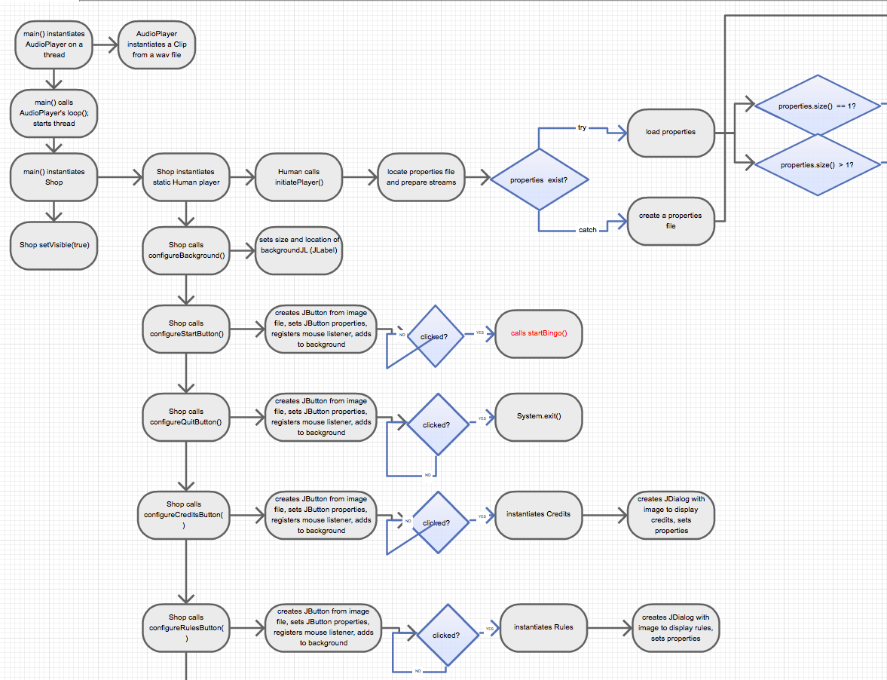
Just a small sample of how the flow of our game is handled.

Slide 25
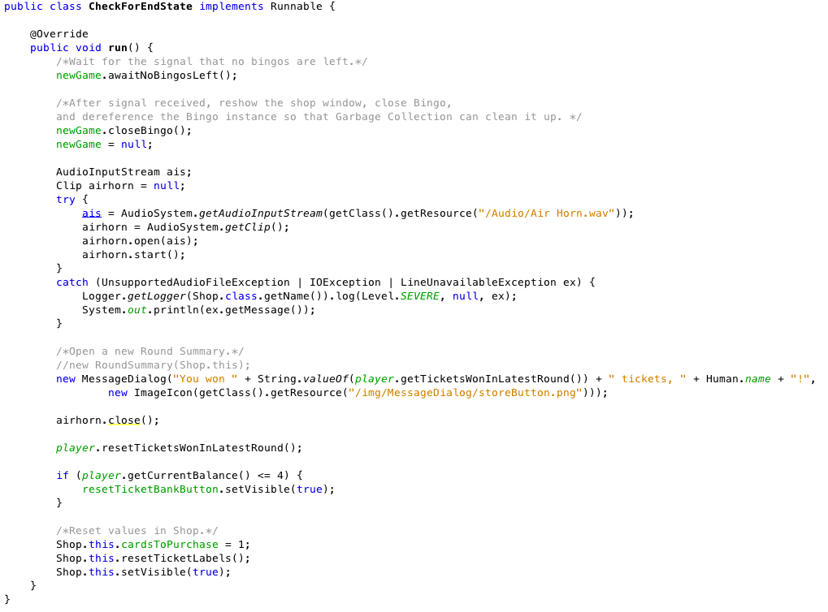

Slide 26
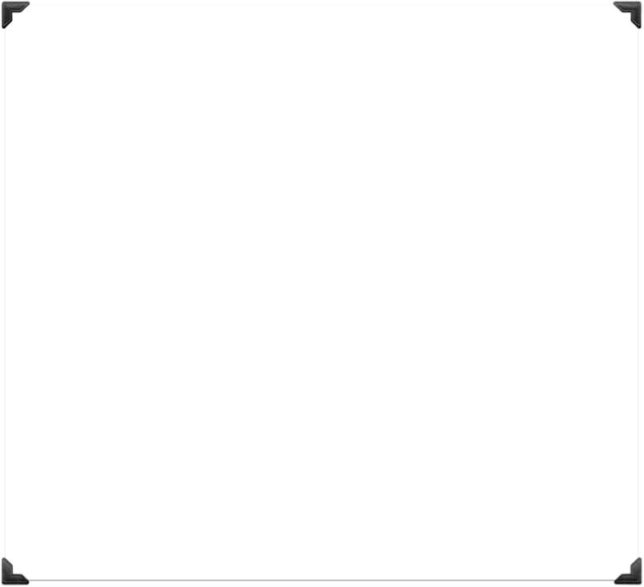
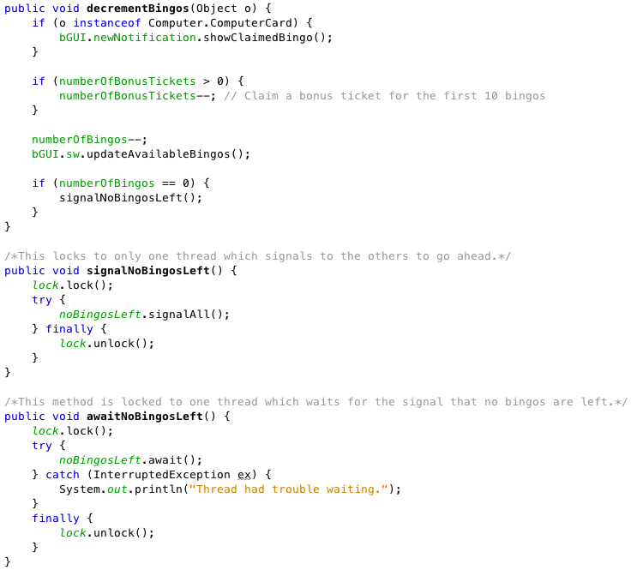

Slide 27
Bingo GUI
Player Card
Master
Card
Ball
Ticker
Status
Window
New Bingo Notification
Greg Knight

Slide 28
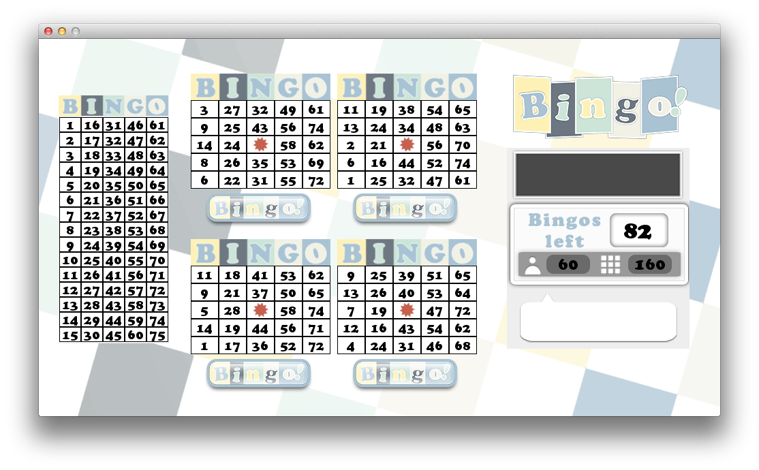
Bingo GUI
One Card
The main Bingo game GUI is designed to accommodate different amounts of cards.
A GridBagLayout was used to place JPanels in the frame. It’s like GridLayout but more flexible.
It allows grid spaces to span multiple rows/columns.
It also uses padding/insets.
Multiple Cards

Slide 29

Abstract Card Class
Defines common elements of MasterCard and PlayerCard
Both say “Bingo” across the top
Both have a GridLayout in the center for displaying Cells and have 5 columns with an undefined number of rows.
Method generateCardLayout() is enforced for subclasses to implement differently

Slide 30
MasterCard
Displays the history of numbers called for an entire round
Does not convey the order in which they were called
Extends Card
Receives int each time a number is called and marks that cell
Column is easy since we know the ranges of each column
The row is determined mathematically
Cell’s toggleToken() is called.

Slide 31
PlayerCard
Cells are assigned random integers with rules
Each column can only have a particular range of 15 integers and numbers cannot repeat
Middle cell is blank and permanently marked
All other cells toggle the marker with a mouse click
PlayerCard has a “Call Bingo” button to claim a Bingo which, if valid, removes the card from play and if not, freezes the card
A custom cursor appears when hovering

Slide 32
Generating Card Layout
For each new coordinate, a random “candidate” int is generated
Within proper range for its column
Checks cells above to see if it is already on the card and, if so, randomly generates another
In testing, “re-rolls” only occur a few times per card
MouseAdapter added to each cell to trigger toggleToken()
Center “free” space is made
This displays no number visually but internally the number is -1 and is interpreted as a number that has been called during validation

Slide 33
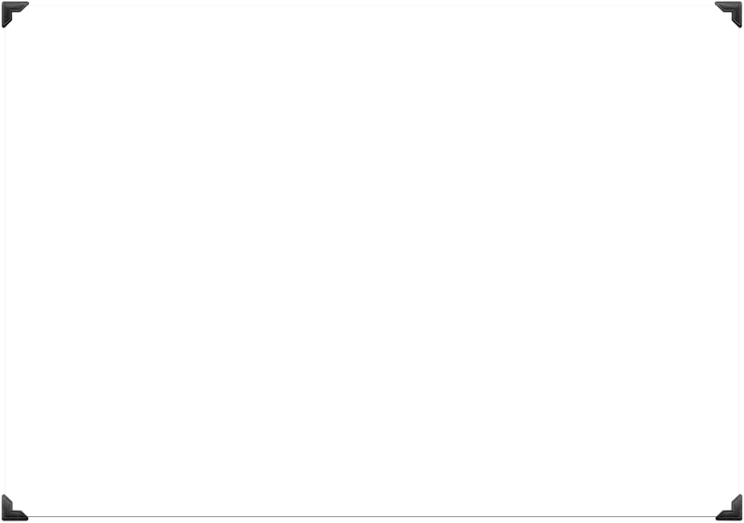
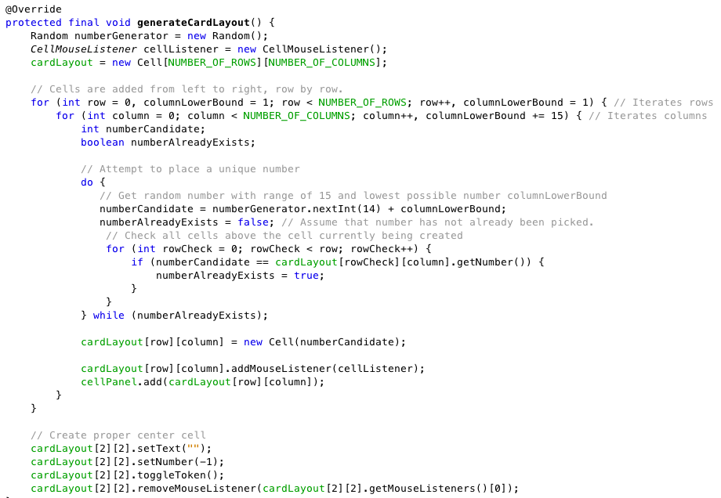

Slide 34
Check for Valid Bingo
Sidney Eubanks
There are 13 possible ways to get a Bingo (5 horizontal, 5 vertical, 2 diagonal, and all 4 corners)
Loops through each possible combination, moving onto new combination if a cell is unmarked
It must also check to see if the numbers in the pattern have actually been called. If they have, isValidBingo() breaks
The card is then replaced with a panel indicating that the player has won and remains there for the rest of the game
If the Bingo was not valid, a freeze panel is put in place for 5 seconds, preventing the player from seeing or placing any tokens

Slide 35
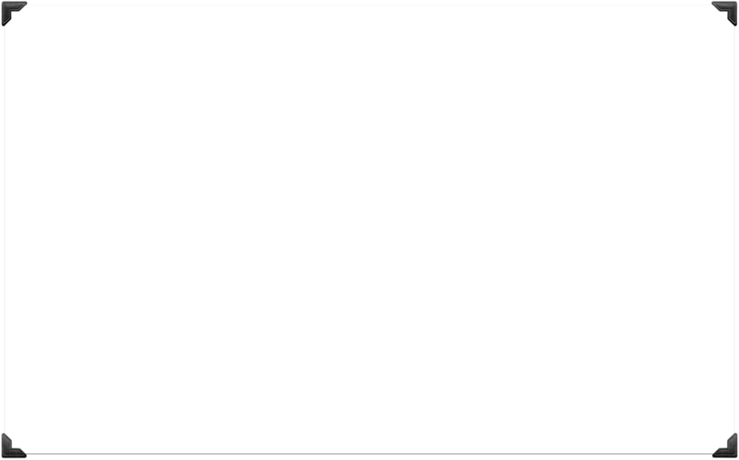
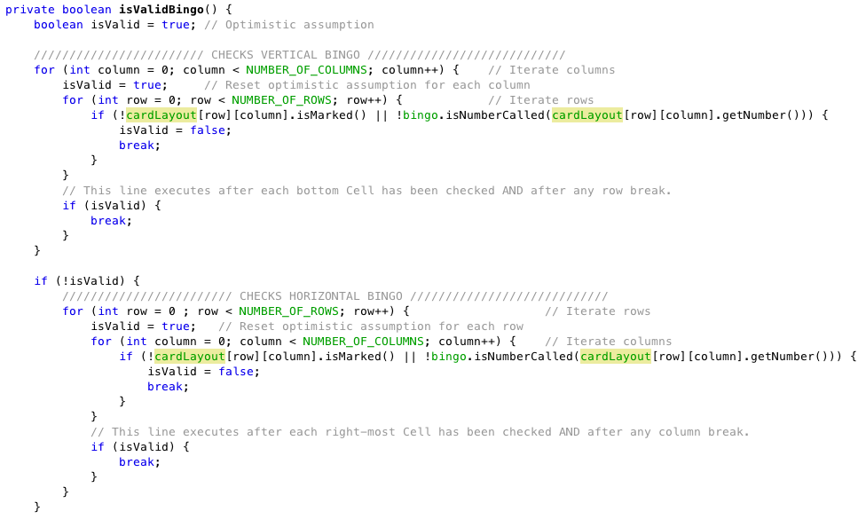

Slide 36
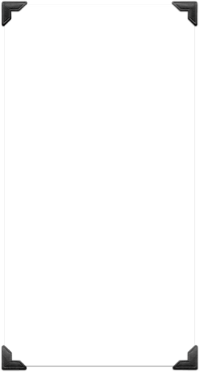
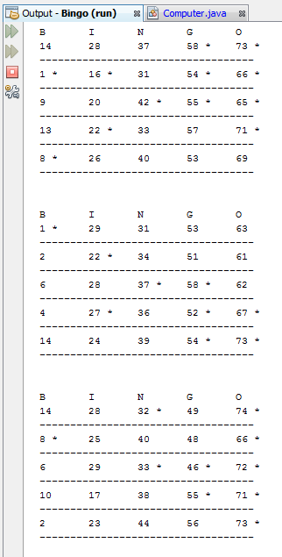
Computer Players
Greg Knight
Accept called numbers into memory queue
They then grab the numbers from their queue based on random response time
They search their cards, mark numbers, and call bingos
Do not have full-on card objects. They have an array of “computer cards” that are more efficient than a “player card”
They are realistic because they can both miss numbers if they are too slow and also not notice a valid pattern sometimes
To test their output (since it was not visual like the player cards) we printed their cards to the console

Slide 37
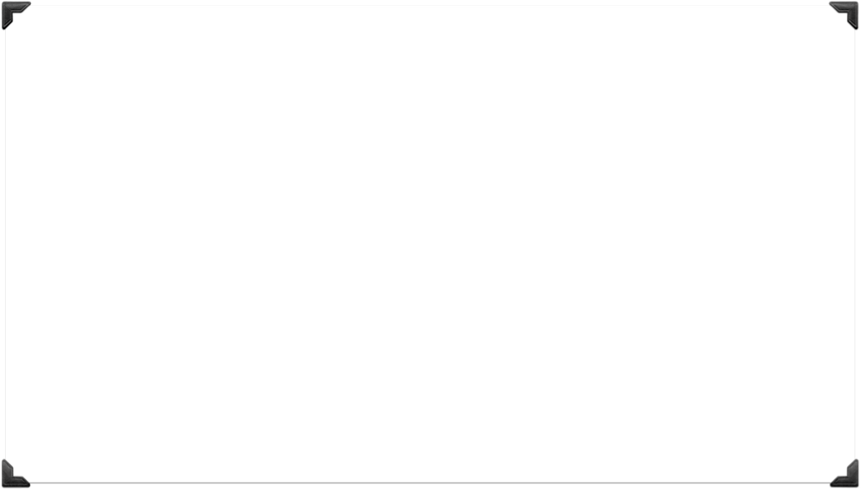
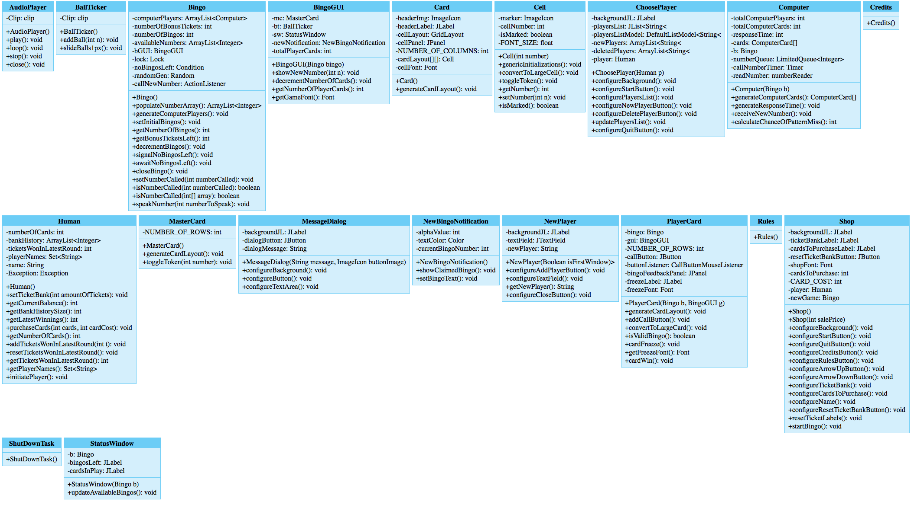
Class Diagram

Slide 38
Incomplete Stuff
Implement Historical Winnings Chart
Allow shop to have random chance of sale
Allow random chance of pre-marked “free” cells
Grayscale or muted Call Button for when PlayerCard is won or frozen
Fade out music in shutdown hook
Let PlayerCards earn multiple Bingos if multiple patterns exist when called
Add white stroke around numbers text
Complete UML with relationships and associations

Slide 39

More Stuff
Game Font
Player Persistence
ChoosePlayer/NewPlayer
Ball Ticker
Calling Numbers
New Bingo Notification
Message Dialog
Reset Tickets
Credits/Rules
Shutdown hook
Background music
Shop GUI
Close Bingo
Cells

Slide 40
Statistics
2,541 Lines of Code
77,138 Characters
19 Classes
212 Git Commits
80 Closed Issues
21.5 MB Jar

